Slide 1


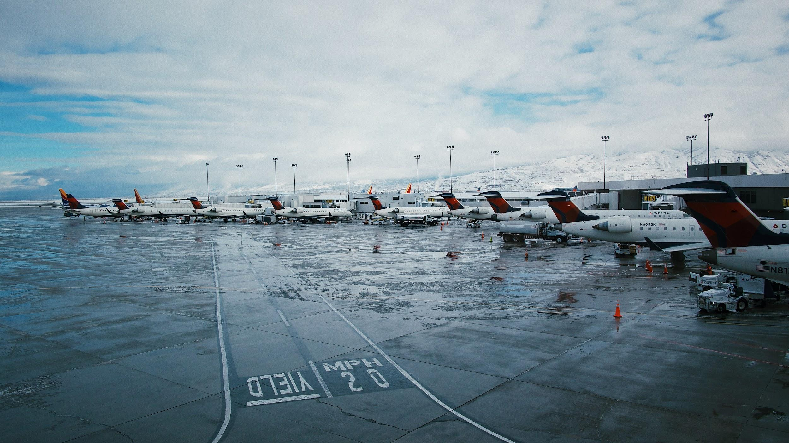

Predicting Flight Delay
Crafted by:
Leonel Baudrit
Dean Bernocchi
Jason Glascock
Bailey Spraggins

Slide 2
Economic Impact of Flight Delays
FAA found that “inefficiency in the air transportation sector increases the cost of doing business for other sectors, making the associated business less productive.” [1]
The total cost of flight delays in 2018 $28 billion dollars [2]
Harvard business School “business travel actually causes economic growth.”
US business travel contributed 1.5 Trillion dollars to the global GDP in 2019 [3]
Business travelers essential to airline financial stability
12% of airline passengers are business travelers, but they represent up to 75% of an airline’s profit [4]
Total Delay Impact Study A Comprehensive Assessment of the Costs and Impacts of Flight Delay in the United States, National Center of Excellence for Aviation Operations Research (NEXTOR), November, 2010
U.S. Passenger Carrier Delay Costs, airlines.org
Knowledge diffusion in the network of international business travel, Nature Human Behaviour, Michele Coscia, Frank M. H. Neffke & Ricardo Hausmann, The Growth Lab, Harvard Center for International development, 10 August 2020
How Much of Airlines' Revenue Comes From Business Travelers? investopedia.com, Jul 15, 2019

Slide 3
Why Predict Flight Delays
Challenge that many encounter
Better understanding of the factors that lead to delays could improve ability to avoid delays
From the perspective of FAA
Use the information to help streamline their current processes:
Identify Factors Driving Flight Delays
Eliminate/Mitigate Factors Driving Flight Delays
Use identified factors to provide better information to the consumer when selecting a flight
Air Traffic is predicted to increase, FAA can use existing information to enact changes

Slide 4
Source Data Description
US Flight Data for the month of Jan 2019 and Jan 2020
https://www.kaggle.com/divyansh22/flight-delay-prediction
Airport Details
http://www.airportcodes.org/
Weather Data
Historical Weather API | Historical Weather

Slide 5
Source Selection Criteria
Flight data from single months in two years:
Covid Impacts: January was believe to not be impacted
Two different years: to give addition volume to the machine model
Only two months of data: Limited Computing and Storage resources
Time available for processing - small scope project
Limited access to free historical weather data

Slide 6
Target Questions To Be Answered
Determine Factors that impact flight delays:
Airport
Airline
Number of Flights
Type of Plane
Flight Diverted
Day of Week/Time of Day
Length of Flight
Proceeding flight impact
Domestic vs. International
Weather (additional data needed)
Number Gates (additional data needed)
From the data we have can we predict flight delays

Slide 7
Overview
Initial exploration of the flight data was achieved using Jupyter Notebook
Two datasets from January 2019 and 2020
Both datasets have 20 columns
There were multiple columns that did not add unique information and were excluded. Example: Origin was selected to be include in the analysis, Origin Airport seq ID, Origin airport ID were not included
Some columns were excluded because they would be too known prior to a flight and so were excluded. Examples: Arrival Delay at the destination, whether the flight was Cancelled or Diverted.
None of the rows had missing data, so no rows were removed.

Slide 8
Overview
Weather Data:
One of the question we wanted to understand was the impact of weather on flight delays.
Flights dataset did not contain weather data so it was necessary to source the weather information from another location.
Hourly weather data from January 2018, 2019, and 2020 was imported using the historical weather API from World Weather Online.
Database
Use AWS to store all flight and weather data
Use PostgreSQL to connect to the database in order to create and merge tables
Create an ERD for the database

Slide 9
Data Exploration

Slide 10
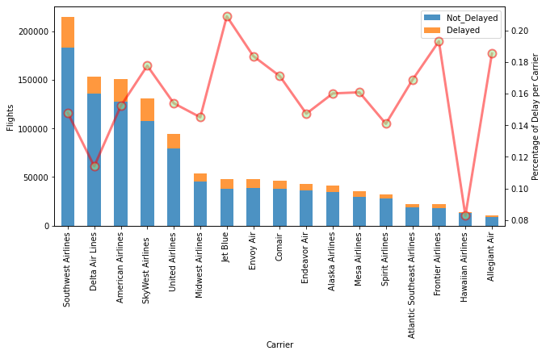
Airlines and the percentage of delayed flight vs total flights for January 2019 and January 2020 flights
-
Notes:
Slide Owner: Leo
The first parameter is percentage of delays based on flight carrier or Airline. Out of the total amount of flights per each airline, what is the percentage of flight delays?
In this graphic we have Southwest Airlines with the highest number of flights, more than 200,000, yet only close to a 15% of these were delayed. Jetblue appears as the airline with the highest percentage of flight delays and almost a quarter of the amount of southwest airlines flights.

Slide 11
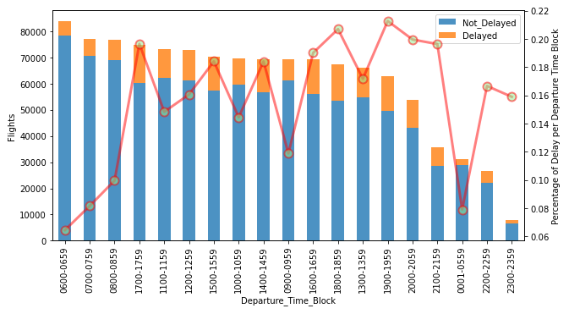
Flights delays per Departure Time Block for January 2019 and January 2020
Notes:
Slide Owner: Leo
The second parameter is percentage of delays per departure time block. These are blocks of 1 hour each. Out of the total amount of flights per each departure time block, flights from 0600 to 0659 have the highest amount of flights and only a 6% of flight delays. The highest percentages of flight delays occur between 1600 and 2000 hours. This information makes sense as these hours are when there is more traffic at the airport.

Slide 12
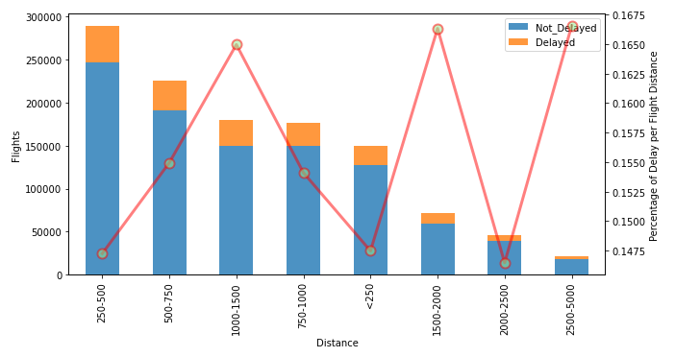
Percentage of flight delays per flight distance for January 2019 and January 2020 flights.
Notes:
Slide Owner: Leo
As our third parameter, is percentages of flight delays by flight distance. The highest percent of delays are for flights with distances of 2500 and 5000 yet with a similar percentages flights between 1500 and 2000 miles. It is important to observe that these percentages are based on a much lower number of flights. Flights between 1000 and 1500 miles with a much larger amount of flights has a really similar percentage.

Slide 13
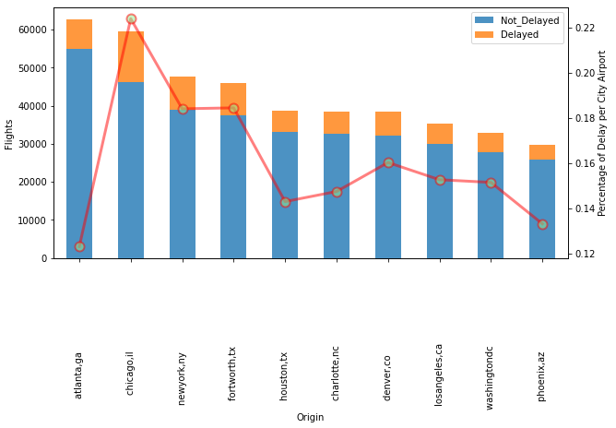
Top ten airports with the highest percentage of flights delay for January 2019 and January 2020
Notes:
Slide Owner: Leo
The fourth parameter is the percentage of flight delays per airport. This dataset contains information about 300 plus airports, so we decided to look at the top 10 airports based on total flights. The highest percentage of delays is for the Chicago Midway International Airport, in chicago,il with a 22% of flight delays and with the second highest number of flights. And even though the Atlanta, GA airport has the highest amount of flights, it is the airport with the lowest percentage of delays with only a 12%.

Slide 14
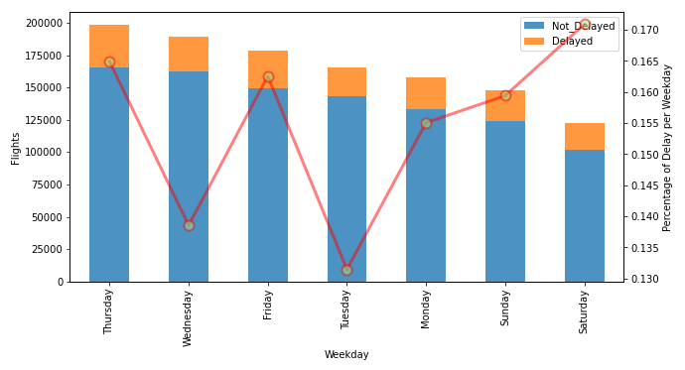
Flight delays per weekday for January 2019 and January 2020 flights
Notes:
Slide Owner: Leo
Finally, the last parameter is delays per weekday. The highest number of flights are on thursday yet the highest number of delays happen on Saturday Both percentages are really close, but it is important to see that there are less flights on Saturdays.
Having this exploratory information helps us to better test the accuracy of our machine learning model, which Jason will talk about next.

Slide 15
Analysis: Machine Modeling

Slide 16
Preparing data for Modeling
Selection of critical information that the user would provide or would be provided from a lookup table was performed.
The target column was identified to be Flight Delay of 15 minutes or more. It was either a value of 0 or 1 (1 being delayed)
Feature data was formated so it could easily be evaluated by the model:
Numbers were formated at integers
Category information were converted into numerical data:
Category data with less than 20 unique values were encoded using Pandas get_dummies
Category data with more 20 or more unique values were encoded using sklearn’s labelEncoder.
After the dataset was split into training and testing datasets, the numerical data was finally encoded using sklearn’s StandardScaler

Slide 17
Model Selection
Since the target was either a 1 or 0, the models that would be used needed to be logistical in nature.
It was noted that there are far fewer delayed flights vs. on-time flights, as a result when evaluating the effectiveness of the model precision, recall and f1-score needed to be used focusing on predicting delayed flights
For the initial Model selection we did not include weather data to determine how effective the model would be without it and how critical that information is.
Based on excluding weather data, it was determined that adding it significantly improved the f1 score.

Slide 18
Model Scoring | Predicting Delays
Below is a table of the models used and the resulting scores when weather data was not included in the features:
Model | Precision | Recall | f1-score
LogisticRegression | 0 | 0 | 0
Decision Tree | 0.27 | 0.29 | 0.28
Random Forest | 0 | 0 | 0
NeuralNetwork | 0.52 | 0.01 | 0.01
Next step is to incorporate the weather data.

Slide 19
Model Scoring | Predicting Delays | Weather Included
Below is a table of the models used and the resulting scores when weather data was included in the features:
Model | Precision | Recall | f1-score
LogisticRegression | 0.38 | 0 | 0
Decision Tree | 0.42 | 0.35 | 0.38
Random Forest | 0.38 | 0.26 | 0.31
NeuralNetwork | 0.72 | 0.04 | 0.08
Based on this analysis it was clear weather data needed to be included
Model selection going forward was Decision Tree
Further Exploration is needed: Additional Data, Model Refinements

Slide 20
Confusion Matrix | Decision Tree | With Weather
 | Predicted: No Delay | Predicted: Delayed
Actual: No Delay | 177,100 | 15,022 | 192,122
Actual: Delayed | 26,415 | 9,183 | 35,598
 | 203,515 | 24,205

Slide 21
Dashboard

Slide 22
Dashboard
User Steps
The user inputs the origin state, origin airport, and destination state
The dashboard populates the destination airport list
The user selects the destination airport and travel date
The dashboard populates the airline with flights to the destination
The user selects the airline
The dashboard populates the flight delay information
For each hour between 5AM and 8PM the following is displayed
Red indicates that a flight that departs during the hour will be delayed
The origin airport weather for that departure hour
Weather information displayed is used by the model to predict the probability of delay for that hour.

Slide 23
Dashboard Web Page Design
The dashboard relies on the d3 javascript API and Flask API
All dynamic content on the page is populated by d3.json() ajax calls
The flask server return a JSON data object based on the d3.json URL
d3.select() is used to populate the dashboard HTML DOM objects that display dynamic content
<select> controls
Flight data display <table>

Slide 24
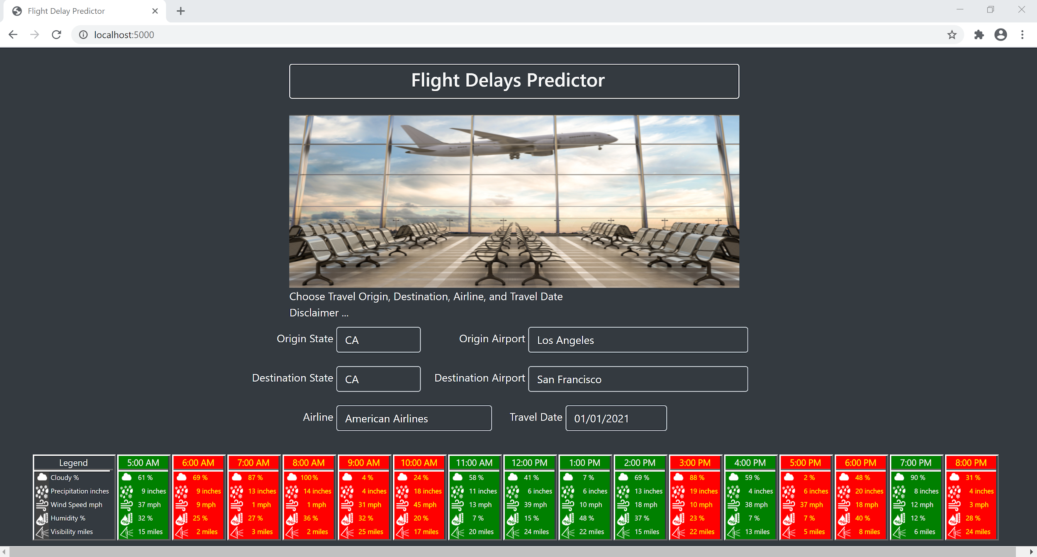
Flight Delay Dashboard

Slide 25
Technologies, languages, tools, and algorithms
Technologies:
AWS
Languages:
Python (pandas, numby, sklearn, pickle, tensorflow, sqlalchemy)
HTML (d3)
JavaScript (flask)
PostgreSQL
Tools:
Jupyter Notebook
Visual Studio Code
Algorithms/Models:
LogisticRegression
Decision Tree
Random Forest Classifier
NeuralNetwork

Slide 26
Recommendation for future analysis

Slide 27
Factors of flight Delays
The current model predicts flight delays based solely on flight trip features
Flight origin
Flight destination
Time of day
Departure time
Distance
But these factors may also be proxies for other factors causing delays

Slide 28
Worst Airports for Flight Delays
Departures on time performance
San Francisco (SFO) – 77.2%
Newark (EWR) – 77.9%
Chicago (ORD) – 78.1%
Phoenix (PHX) – 79.8%
Houston (IAH) and Chicago (MDW) tied – 81.4%
Arrivals
San Francisco (SFO) – 72.9%
Newark (EWR) – 74%
Phoenix (PHX) – 76%
New York City (LGA) – 79%
Seattle (SEA) – 79.5%
https://www.fly.com/blog/travel-tips/5-best-and-5-worst-airports-for-delays/

Slide 29
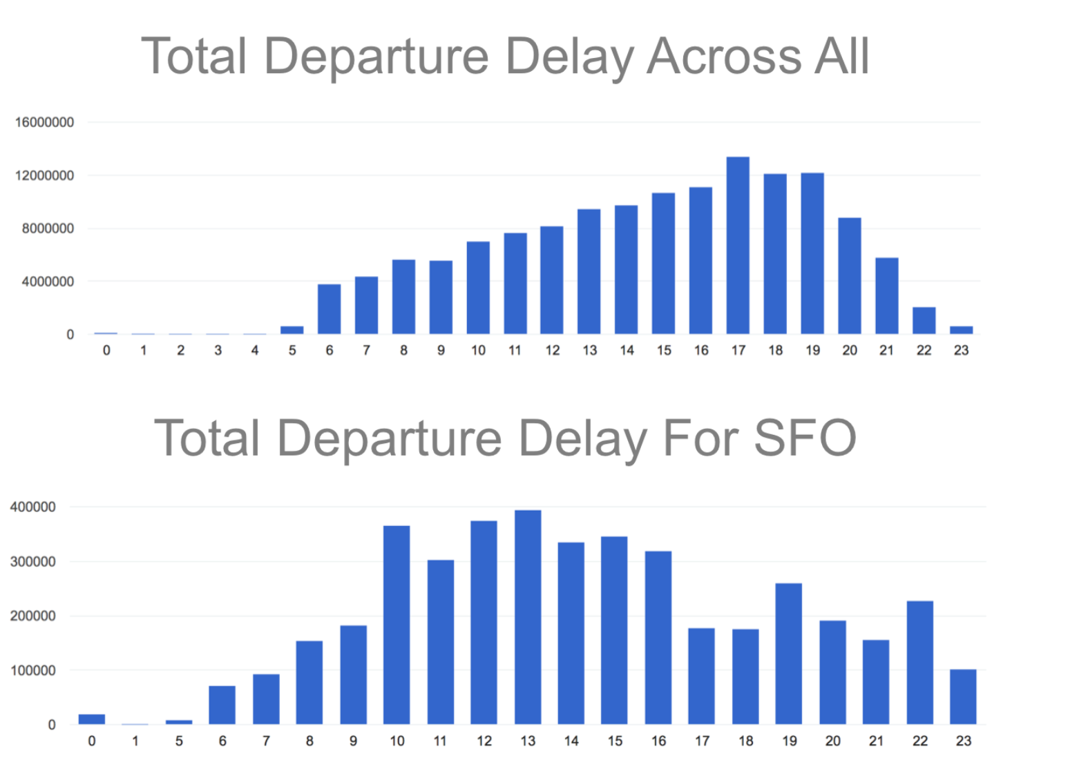
SFO Delays Vrs US Average Delays by Hour
Average flight delay pattern
Gradual buildup in delay
Delays peak at 5 PM
SFO very different delay pattern from average
Delays spike at 10am
Sustains that peak for 7 hours until 5pm
https://www.openprisetech.com/blog/everything-always-wanted-know-sfo-delayed-flights/
https://www.openprisetech.com/blog/everything-always-wanted-know-sfo-delayed-flights/

Slide 30
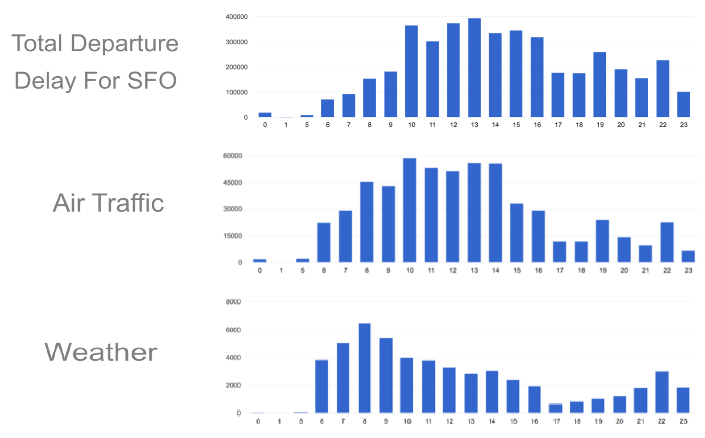
Factors for SFO Unique Flight Delay Pattern
SFO’s unique delay pattern
Airport traffic related delays more correlated
Top traffic 3 delay hours during peak overall delay hours
Weather related delays significantly less correlates with unique delay
Top weather delay hours not correlated with top overall delay hours

Slide 31
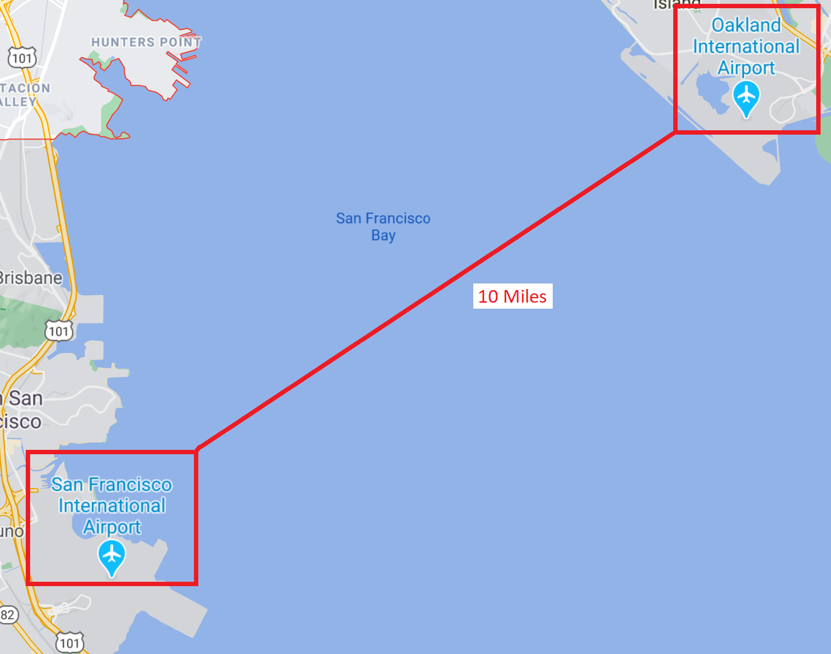
SFO vrs Oakland Ca (OAK) Airport Comparison
Within 10 miles of each other
Have similar weather
Yet SFO is number one
% Departure delays
% Arrival delays
Why is OAK not on the list?
Delays are % values not total.
Expect be the same % values for both airports
Differentiating factor .... ?
Must be airport traffic loads!

Slide 32
Hypothesis to Improve Model’s Accuracy
Using only flight trip information and departure weather can accurately predicts delays for airports
WITH the normal US average flight delay distribution
To more accurately predict flight delays at airport
WITHOUT the normal US average flight delay distribution
Add additional aviation factors to the model
Average airport traffic by day and hour
Air traffic system enroute delays

